Slide 1
Traditional Marketing Vs Digital Marketing
1. Wide Reach
2. Niche Marketing
3. Cost Effective
4. Measurement and Tracking
5. Generates Potential Leads
6. Performance Oriented
7. Real Time Results
8. Audience Control
9. Interactivity
10.Fair Play/Equity
Class-II
Class-II
Class-III

Slide 2

Measurement and Tracking
Tips to measure traditional media – Print and Radio
USE AD-SPECIFIC SUB-DOMAINS OR MICROSITES
USE COUPON CODES / DISCOUNT CODES / VOUCHERS / QR CODES
ASK YOUR CUSTOMERS
MONITOR SALES
It’s almost impossible to measure and track
Source: http://alchemymarketing.co.nz/tips-to-measure-traditional-media/

Slide 3
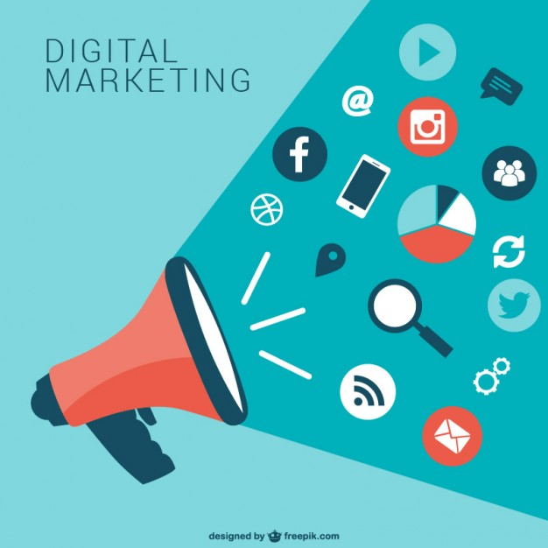




Digital Marketing
Measuring and Tracking Tool

Slide 4

Generate Potential Lead
Lead generation is the process of attracting and converting strangers and prospects into someone who has indicated interest in your company's product or service.
Generation of Lead from Digital Marketing

Slide 5
Lead Generation from Digital Marketing
Landing Page
Sign Up Form
Call-to-Action
Call/Missed Call
Landing Page
A page of the website where customer lands after clicking on online advertisement or a link
Lead Form
Website Page
Product Page
Sign Up Form
An online form though which a user may supply the information to the businesses, if interested
Call-to-Action
Name
email Id
Mobile No.
Other Info
Subscribe Now
Call Now
An Image or line of text usually appears on advertisement and prompts the customer to take the action
Call-to-Action
Learn More
Visit Website

Slide 6
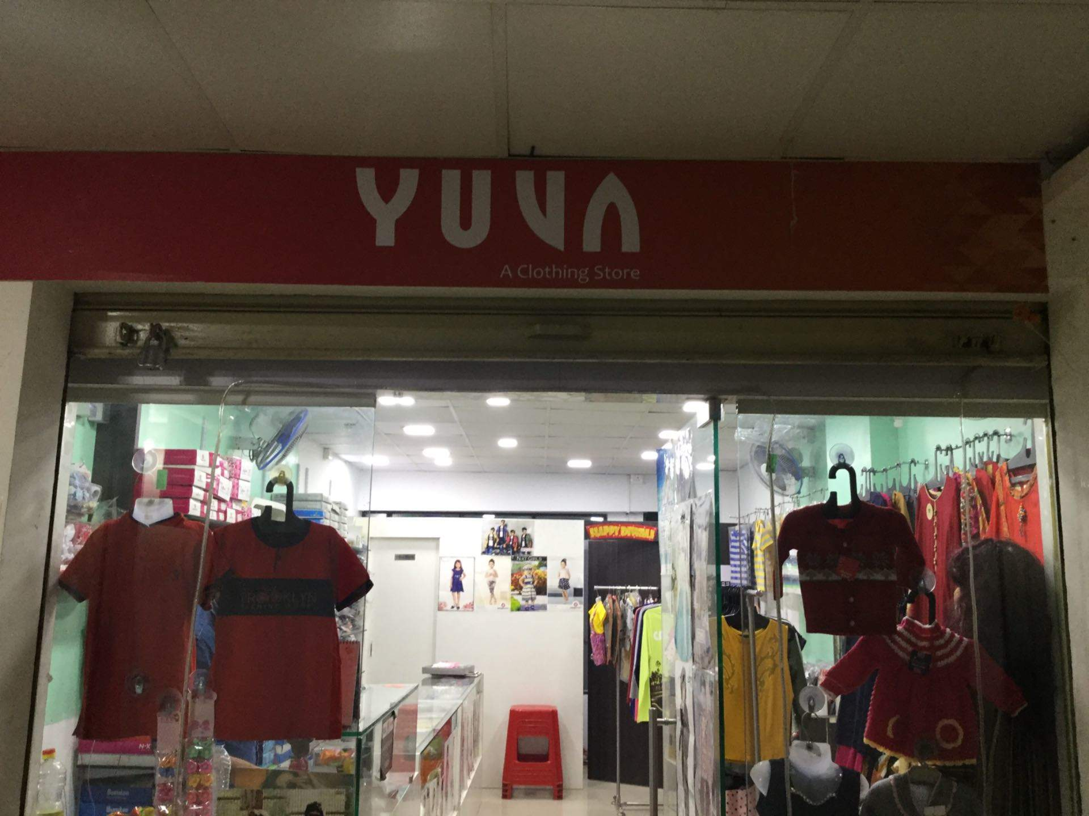
Case Study-Discussion
Yuva Clothing Company
Profile
Established in 1983, Yuva Clothing Company is a leading textile manufacturing unit in Kolhapur. They are amongst the top suppliers in the country that deal with all types of garment production. Yuva Garments is listed as a verified manufacturer offering supreme quality products, selling only in bulk. They have recently decided to extend their services into manufacturing PPE kits based on the certified norms. They wanted to work with digital domain experts who could help them increase leads across digital platforms and promote the PPE kits. Yashus aimed to increase their brand awareness and reach out to the target audience through detailed social media planning and execution.

Slide 7
Challenge
Build a strong social media presence across Facebook through targeted content and attractive images.
Generate leads through paid advertisements for PPE kits bulk order.
The main goal was to only target B2B clients who may require PPE kits for daily work and would be willing to buy it in bulk.
Crisp and clear communication to outrank competitors on the basis of best account management and spend metrics

Slide 8
Solutions
DM Company came up with a two-fold solution- one was to analyse the social media trends and target potential customers and generate leads. The second was to re-market and reach out to users who had previously visited our client’s website and encourage them to follow their social media pages.
The content and creative images that were created for the Facebook paid ad were to the point, highly attractive, and conveyed a clear message about Yuva Clothing’s business vision to sell PPE kits online.
DM Company used an integrated digital marketing strategy to specifically target B2B clients from each specific location.
DM Company team implemented the best cost per click strategy based on every device and pin code.

Slide 9
Result
With the help of expert Facebook marketing strategies, we managed to adhere to and surpass our client’s requirements and managed to deliver the desired results well in time with ROI.
Yashus generated 70% institutional leads within a month of the launch of the lead generation campaign for PPE kits.
The average leads per day increased to 40 leads
https://yashus.in/case-study/yuva-clothing-company-facebook-lead-generation-campaign-case-study/

